Slide 1
Institutional Review Board
Created by Kyle Grondin and Brandon Pichen
Contributors: Kyle Grondin, Brandon Pichen, Anthony Barrios

Slide 2
Background & Problem
The Institutional Review Board (IRB) is a human ethics board at Aurora University that handles applications for research projects
Currently done through email & paper
IT is currently thinking of getting a new document system
Notes:
What is the IRB? Current situation? What is IT doing currently?

Slide 3
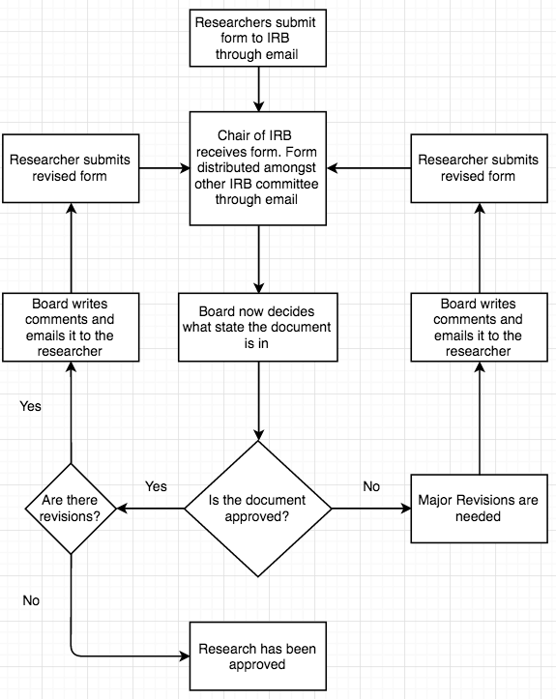
Current Situation
Dependent on email & chair

Slide 4
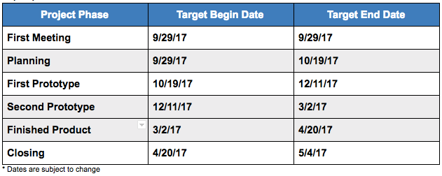
Business Case & Decision
Proposed a personalized web solution
Sprint cycles of 3 weeks with customer Meet ups at the end
Trello for task management
Github for version control
Ruby on Rails with MySQL database
0 costs until maintenance phase
Notes:
Maybe show some diagrams, costs, timetables. Discuss our sprint cycle

Slide 5
Features
Users Can Do:
Submit and Resubmit Applications
Upload supplementary Files
Log in and view ongoing or old applications
Notes:
Features! Pictures, maybe one or two features per slide

Slide 6
Features Cont.
Board Members Can Do:
View every application submitted
Discuss the application with each other through comments
Vote on if the application should be approved/rejected/revised

Slide 7
Features Cont.
Chair of the Board Can Do:
Assign applications to other board members
Change the board members permissions
Has the final say on what state the application is
Posts overall comments on the application that the investigator can see

Slide 8
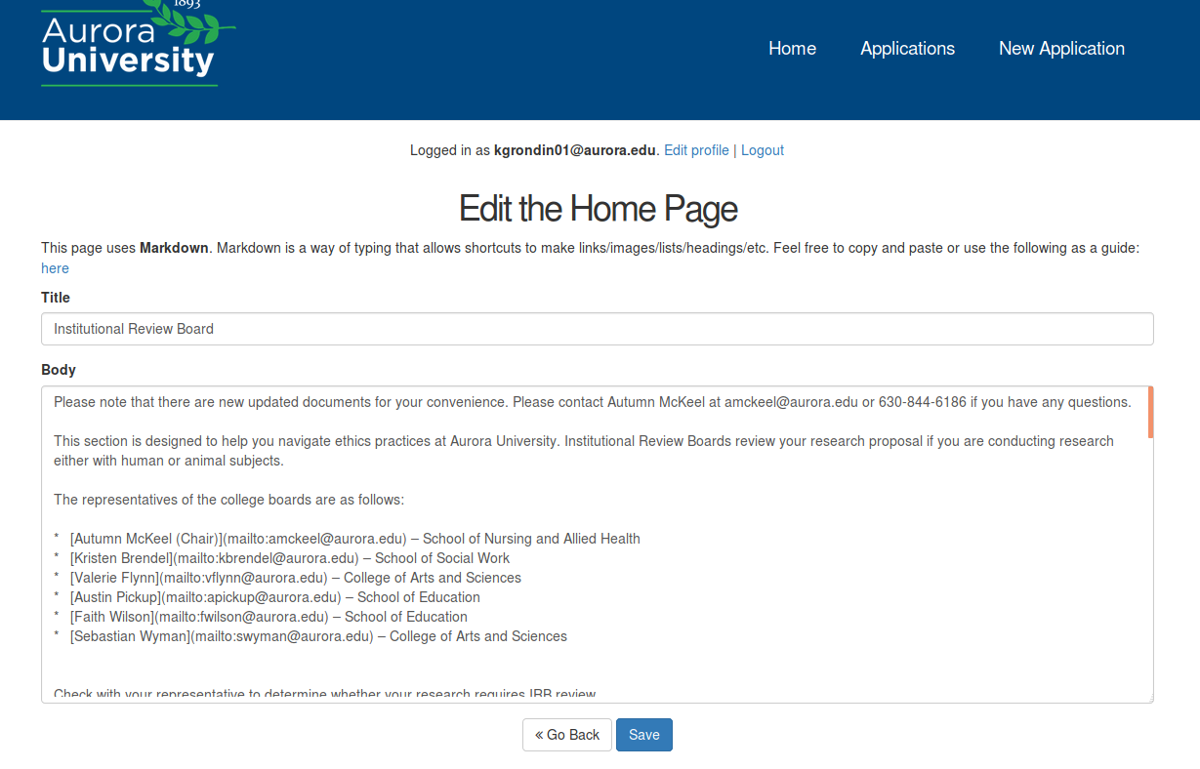
Other Features
Stamping
Email notifications
Editable front page
100% responsive design
Archived Applications
Searching every application sorted by date

Slide 9
Testing
Black Box Testing
User Acceptance Testing
End-to-end Testing
Notes:
How did we test?

Slide 10
Problems Occured
Assignments
Stamping
Auto complete Search feature
Notes:
Self explanatory

Slide 11
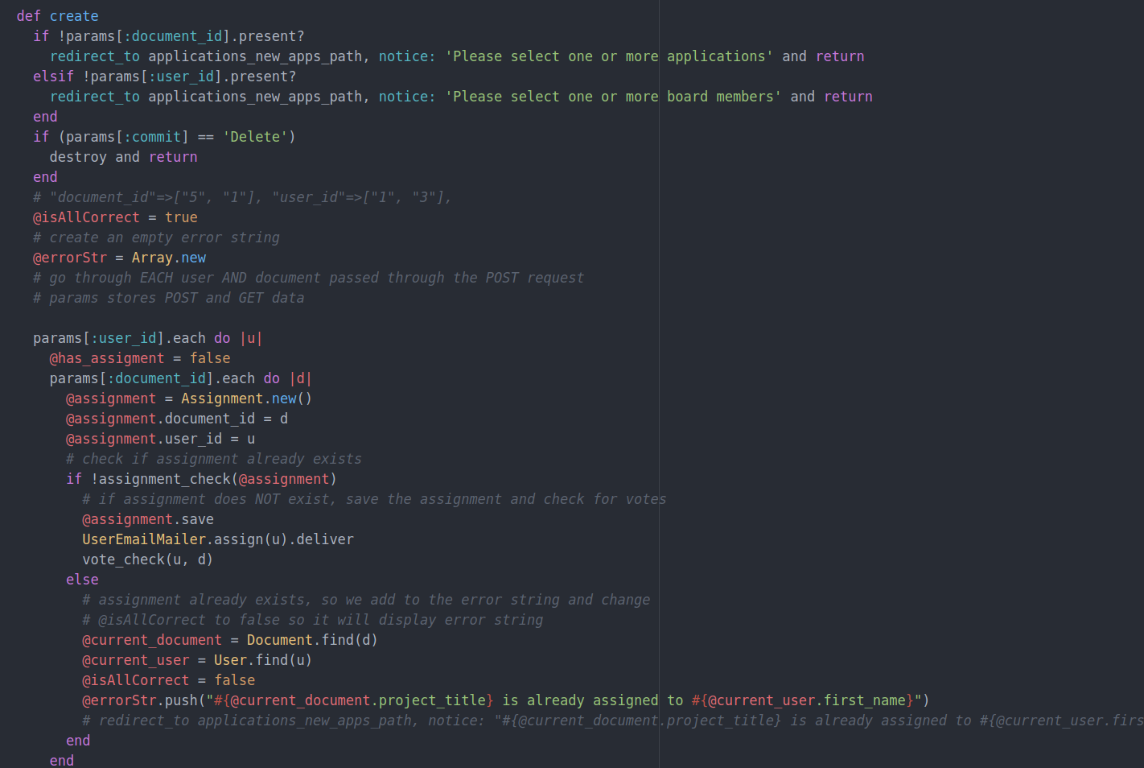
What We Learned
Working with forms forces you to be creative
An in depth look at Ruby on Rails
How to work with a live server
The power of databases
PDFs are extremely touchy
Notes:
Self explanatory

Slide 12
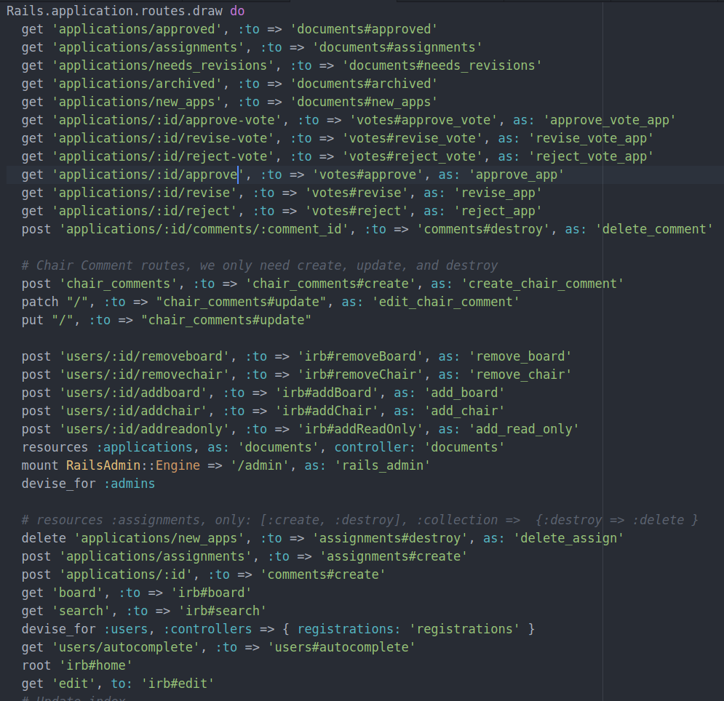
What We Could Have
Done Better
RESTful routing
More testing
Optimize database queries for scalability
Stamping word documents
Notes:
Self explanatory

Slide 13
DEMO

Slide 14
Implementation?
Currently online but not in production
IT currently has not approved
IRB wants to move forward
Possible intern through Comp Sci Department next year for maintenance
Notes:
Current situation. intern?

Slide 15
Documentation
References and APIs
Providing instruction manuals for users
Comments in code
Instructional Videos on github
https://github.com/kagron/irb
https://trello.com/b/xYJGH5s3/irb
http://www.rubydoc.info/
http://api.rubyonrails.org/
http://guides.rubyonrails.org/
https://stackoverflow.com/
https://www.elastic.co/
Notes:
Github link, videos link, other references

